Slide 1

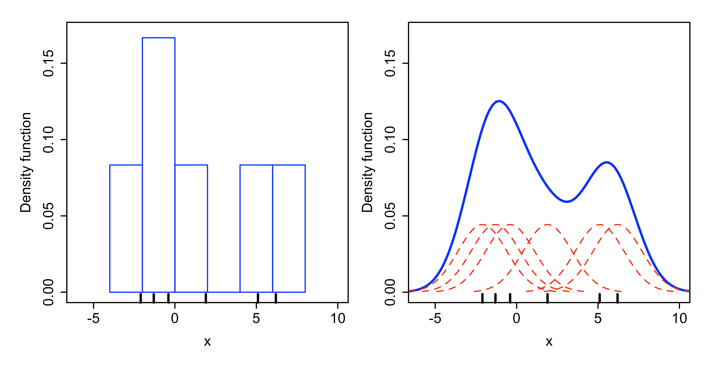
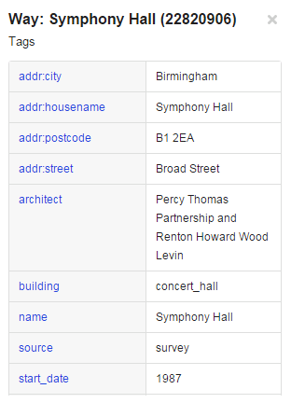
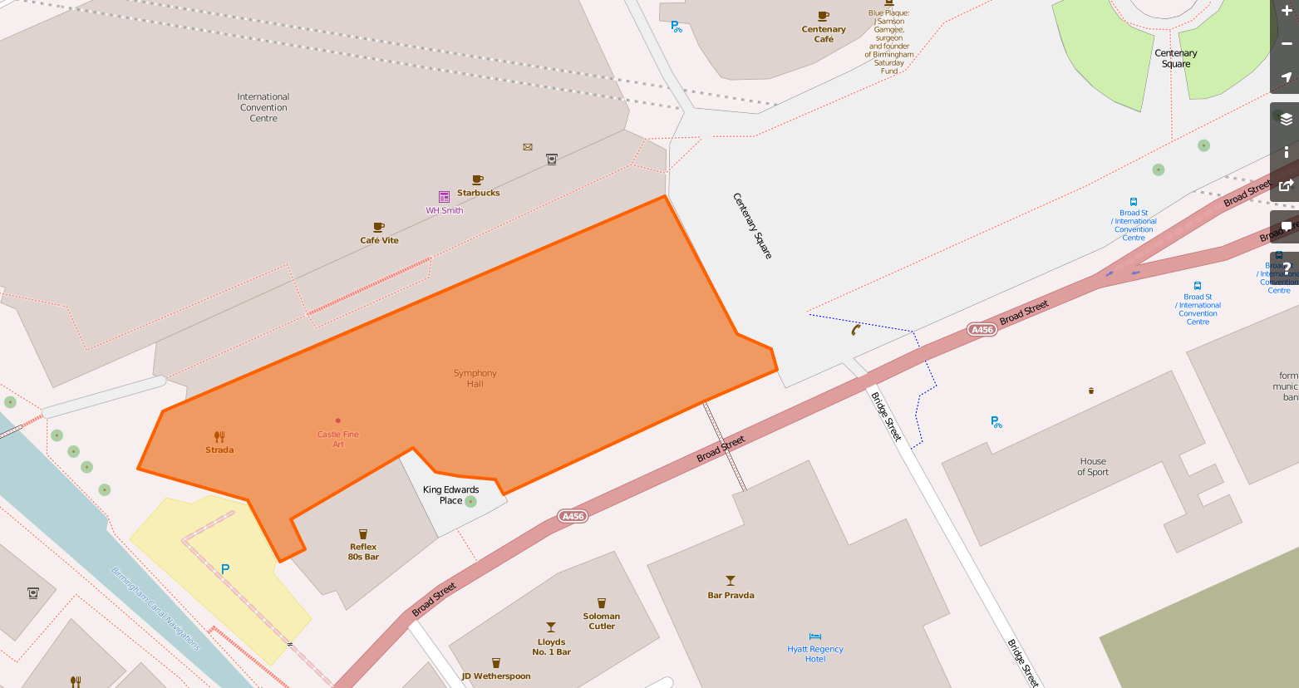
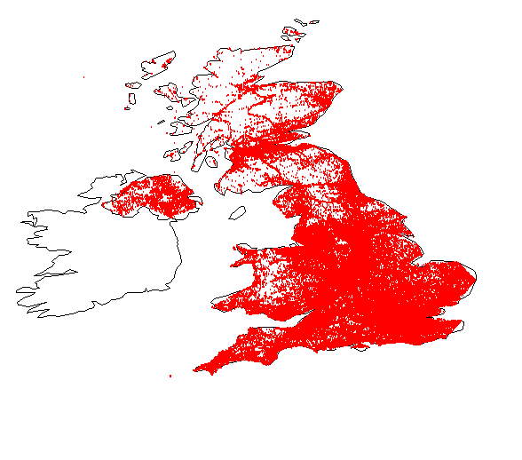
Semantic Annotation of Venues Using Geo-Tagged Social Media Data Carolyn Kiriakos, Xin Chen, Junyi Yang, Fusheng Wang
Department of Biomedical Informatics
Stony Brook
University
Introduction
Experimental Model
Results
Semantic Annotation of Venues
Associates human-readable phrases with named locations to describe their nature and function
Helps update base maps and generate better location recommendations
Geo-tag: the geographic coordinates associated with a social media action
Venues: public spaces or buildings, including libraries, parks, and shops
Kernel Density Estimation (KDE)
Top Keywords Observed at Red’s True Barbecue in Nottingham, UK
“American Savior”, “barbecue”, “bbq house”, “cocktail”, “cracklings”, “French martini”, “indoor beach huts”, “Let There Be Meat”, “lunch meeting”, “meating not eating”, “Red’s Barbeque”, “Red’s Nottingham”, “Red’s Pilgrimage”, “Red’s pit burger”, “Red’s True Bbq”
Non-parametric method of estimating a probability density function from a random sample of data
Previously used to model human location and mobility data
Legend
= Ranked Within Top 30 Keywords by
TF – IDF and Naïve Bayes Only
= Ranked Within Top 30 Keywords by
TF – IDF and KDE Only
= Ranked Within Top 30 Keywords by Naïve Bayes and KDE Only
= Ranked Within Top 30 Keywords by
TF – IDF, Naïve Bayes, and KDE
Baseline Models
Goals and Challenges
Term Frequency – Inverse
Document Frequency (TF – IDF)
Increases the weight of a keyword in a certain region as both its frequency in that area and overall rarity increase
Eliminates common but uninformative words such as “the” and “of”
Naïve Bayes
Assumes that all Tweets coming from a specific location are independent of any others coming from there
Assigns probabilities based on simple counting techniques
Goals
Model the distribution of Twitter key-words using a variety of techniques
Infer the locations and natures of venues in the United Kingdom
Conclusions
Challenges
Methods must scale to large data sets
Tweets are sparse in rural areas, but dense in cities
Baseline methods are more likely to assign the same relevance score to a large set of keywords
Keywords ranked highly by all three methods tend to be informative
All three methods can detect some previously unmarked venues
Web Image Sources – Semantic Annotation of Venues: openstreetmap.org/way/22820906 – Kernel Density Estimation: en.wikipedia.org/

